Slide 1

Ai well-being counsellour
Spring 2023

Slide 2

OUR TEAM
William Reima
Third year student in Tampere University of Applied Sciences studying ICT-engineering with a spezilization to Software engineering
Minna Mellajärvi
First year student of Interactive Media in Tampere University of Applied Scienences, in the Bachelor of Media and Arts degree programme.
O R Imon
Third year student in
Tampere University of
Applied Sciences studying Software engineering.

Slide 3
Table of contents
PRESENT STATE
CHANGE FORCES
FUTURE STATE
DEMONSTRATING OUR VISIONS
DEMO 1: WEBSITE LANDING PAGE
DEMO 2: PRODUCT FEATURES
BACKCASTING
CONCLUSION
PERSONAL INTERPRETATIONS

Slide 4
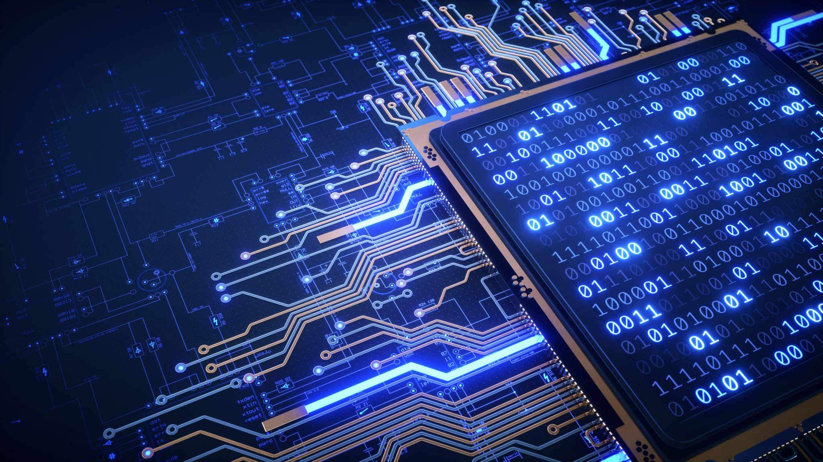
Present state
The increasing use of Artificial Intelligence (AI) is rapidly
changing the way businesses operate. This technology is
causing significant disruptions in the political, economic,
social, technological, legal, and environmental spheres.
AI is indeed a buzzword today, regarded as an umbrella term. It consists of a range of fancy technologies and even be hyped with magic power. It inevitably arouses a broad concern about its potential diverse disruptive impacts on jobs, businesses, and societies. AI was as effective as proficient workers and even four times more effective than newcomers. It enables machines to handle an increasing number of cognitive tasks which used to be exclusively performed by humans.

Slide 5
Change Forces
The change forces driving AI disruption are complex and
multifaceted, requiring stakeholders to adopt a comprehensive
and collaborative approach to navigating this transformative
technology.
While AI holds enormous potential for driving innovation,
productivity, and growth across various industries.
Ultimately, the success of AI will depend on the ability of
stakeholders to work together to develop a shared
understanding of its capabilities and limitations and to foster a
culture of responsible and sustainable innovation.
The change forces driving AI disruption highlight the need for a
multidisciplinary approach to understanding and managing
this technology, one that draws on expertise from fields as
diverse as engineering, law, economics, and social
sciences.

Slide 6
TECHNOLOGICAL
These aspects relate to technological advancements that could have a positive or negative impact on how industry and the market function.
AI as tool to improve efficiency
Technology incentives
Level of innovation
Automation
Research and development
Technological Change
Technological awareness
AI in marketing: With the assistance of powerful, quick computers, AI can process enormous volumes of data, and using that data, it can market all the products you would like or need at the given time testing.
AI in Marketing
Data collection
Data processing
Data analysis
Personalization
Automation
Optimization

Slide 7
Economic
Economic factors are determinants of a certain economy’s performance. Factors include economic growth, exchange rates, inflation rates, interest rates, business sector investments, disposable income of consumers and unemployment rates.
These factors may have a direct or indirect long term impact on the topic, since it affects the purchasing power of consumers or could possibly change demand/supply models in the economy or certain business area.
Economic
Impact on job market
Economic recession
Labor costs
Market competition
Consumer Demand
Exchange Rate

Slide 8
SOCIAL
The demographic features, norms, customs, and values of the population or particular stakeholders are represented by this aspect of the general environment.
This includes demographic patterns including the pace of population growth, age and income distributions, attitudes toward careers, a focus on safety, a concern for one's health, attitudes toward a certain way of living, preferences for certain types of consumption, and cultural obstacles.
Social
Public Perception
Demographic Changes
Education and Training
Workforce Changes
Health and Safety Concerns
Social Media and Networking

Slide 9
lEGAL
These considerations include more specific laws including discrimination laws, antitrust laws, employment laws, consumer protection laws, copyright and patent laws, as well as laws pertaining to health and safety, even if there may be some overlap with the political factors.
It is obvious that businesses need to understand what is and is not lawful in order to do business profitably and morally. Legislative trends and advancements relating to the phenomena of exportation can also be found.
Legal
AI Act of the European Union
Privacy and data protection
Legislation as a driving force for AI

Slide 10
political
AI can create new ethical and legal challenges that may have political implications. The rise of AI may also impact international politics, particularly in the areas of national security and military technology.
The main cause of AI for business disruption with political implications is the potential for AI to automate tasks that were previously performed by humans
Political
Government approach
Political steadiness or insecurity
Corruption
Remote exchange
approach
Assess approach
Work law & Natural law
Tax, Education, Healthcare Policy

Slide 11
environmentAL
AI has the potential to bring significant benefits to the environment by enabling more sustainable and efficient production practices.
Examples:
Fighting climate change with AI
Environmental footprint of AI
These factors include ecological and environmental aspects such as
Environmental
Climate
Farming and agriculture
Energy costs
Tourism
Natural Disasters
Insurance

Slide 12
Future state
In order to narrow down the exact future state that we would like to explore in our project study, we asked some pretty bold ”What if…” –questions. Our goal was to aim for a positive outcome, although some of the questions were on the line of ”What if AI takes over the world?”.
What if you could make an AI model yourself easily?
”What if everyone could have their own AI life coach?”
“What if AI does all the boring and tedious work for us?”
We held on to the idea of AI being able to coach us through our everyday lives, making it easier for us to make wise decisions based on our needs and wants, and also taking care of some of the tedious tasks, so that we would be able to focus on the more important things.

Slide 13

Demonstrating our visions
As we are all students from the web and app background, we wanted to create some demos that showcase our own strenghts.
The first of these demos is a template for a so-called landing website that promotes the product and urges customers to buy it. We have used the AI model ChatGPT to help us write the ad texts based on the facts that we provided it regarding our product.
The second one is a mock up of how would the product work in real life, made with the technology available and well known for us at the moment.

Slide 14
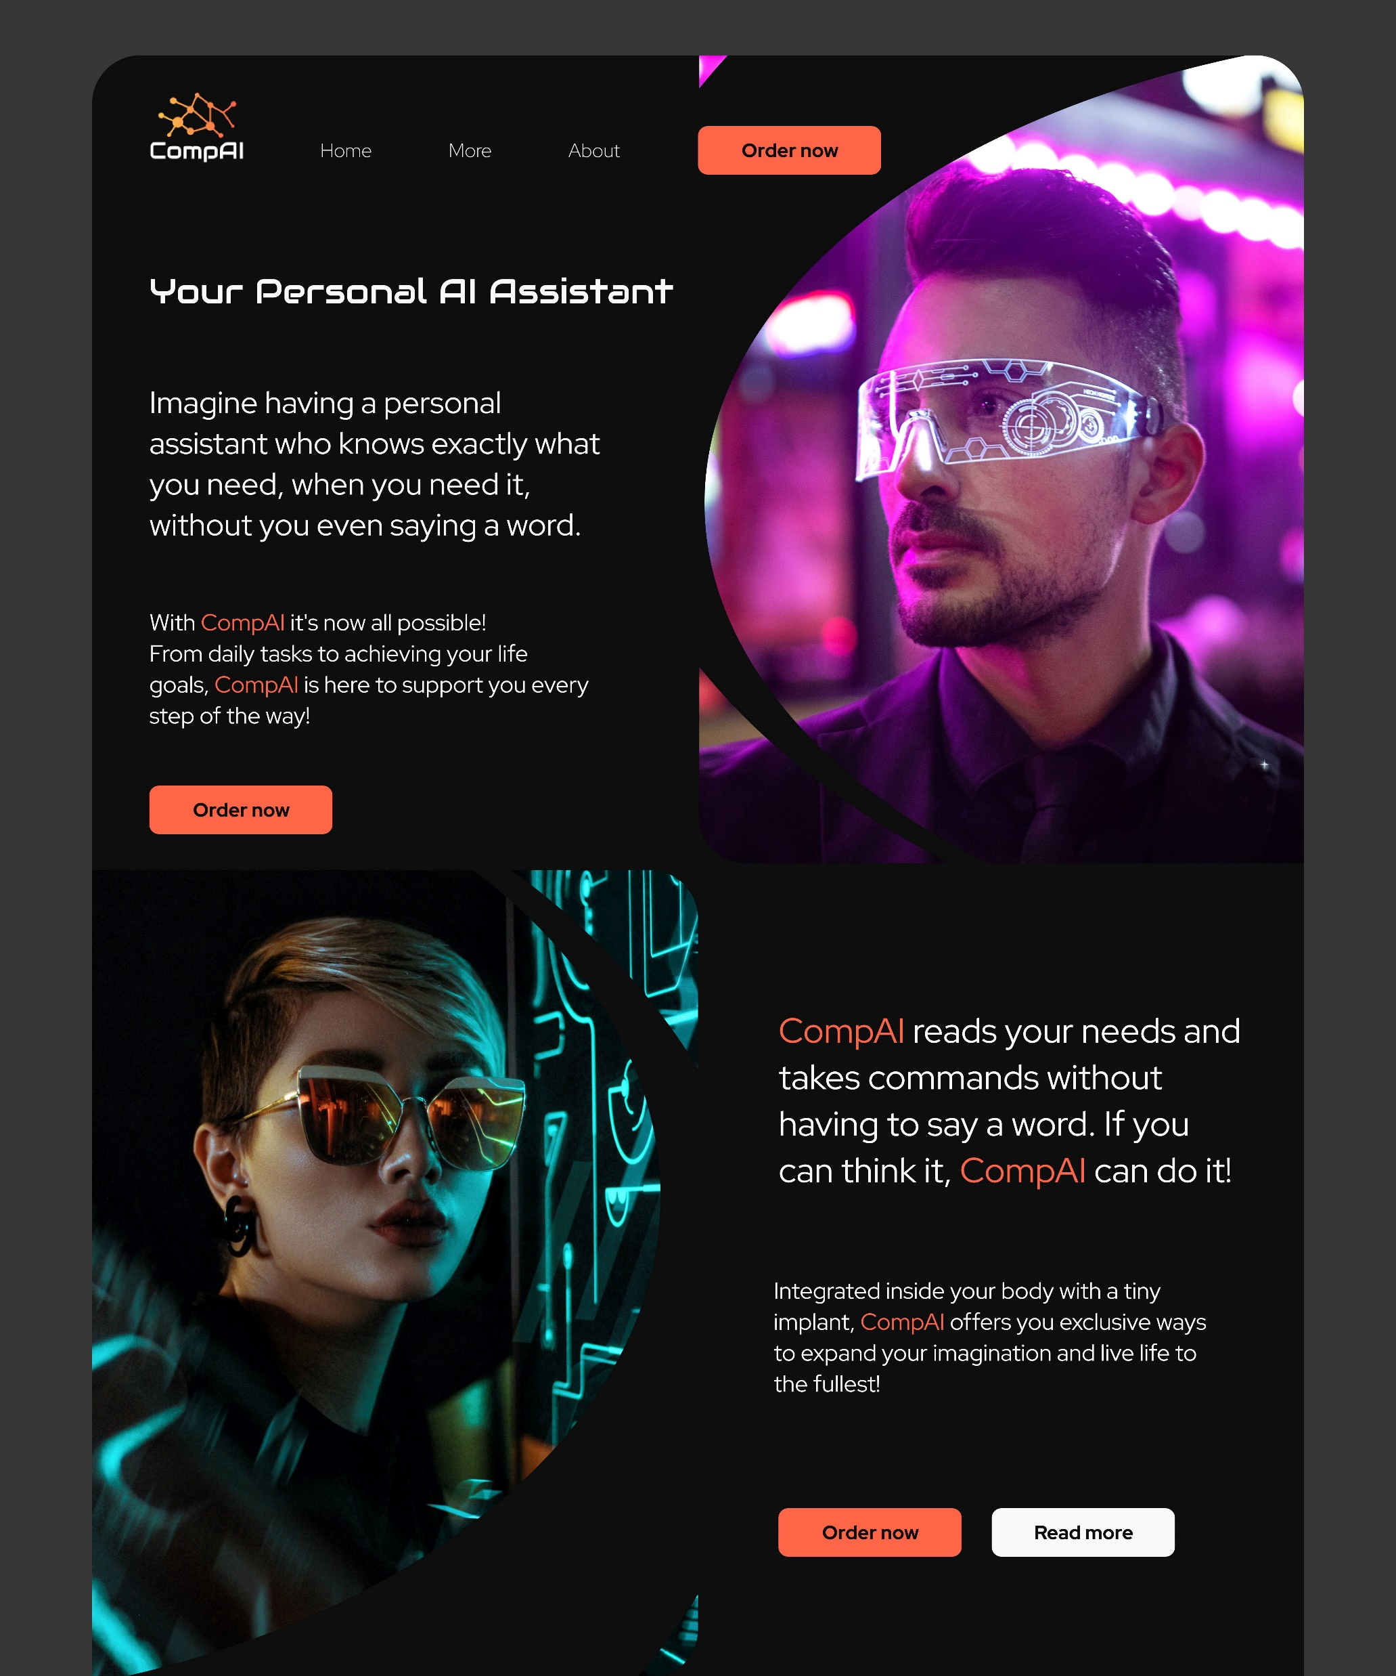
Demo 1:
Website landing page

Slide 15
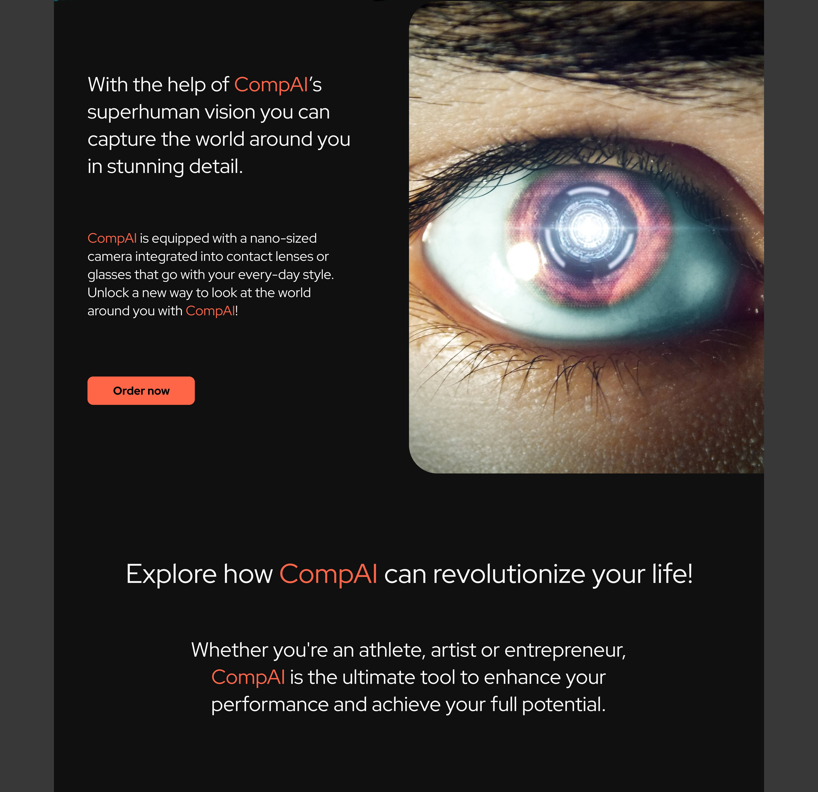
The name CompAI refers to companion and Artificial Intelligence. One other writing format we considered was ComPAI, where PAI would’ve been an abbreviation for Personal AI.

Slide 16
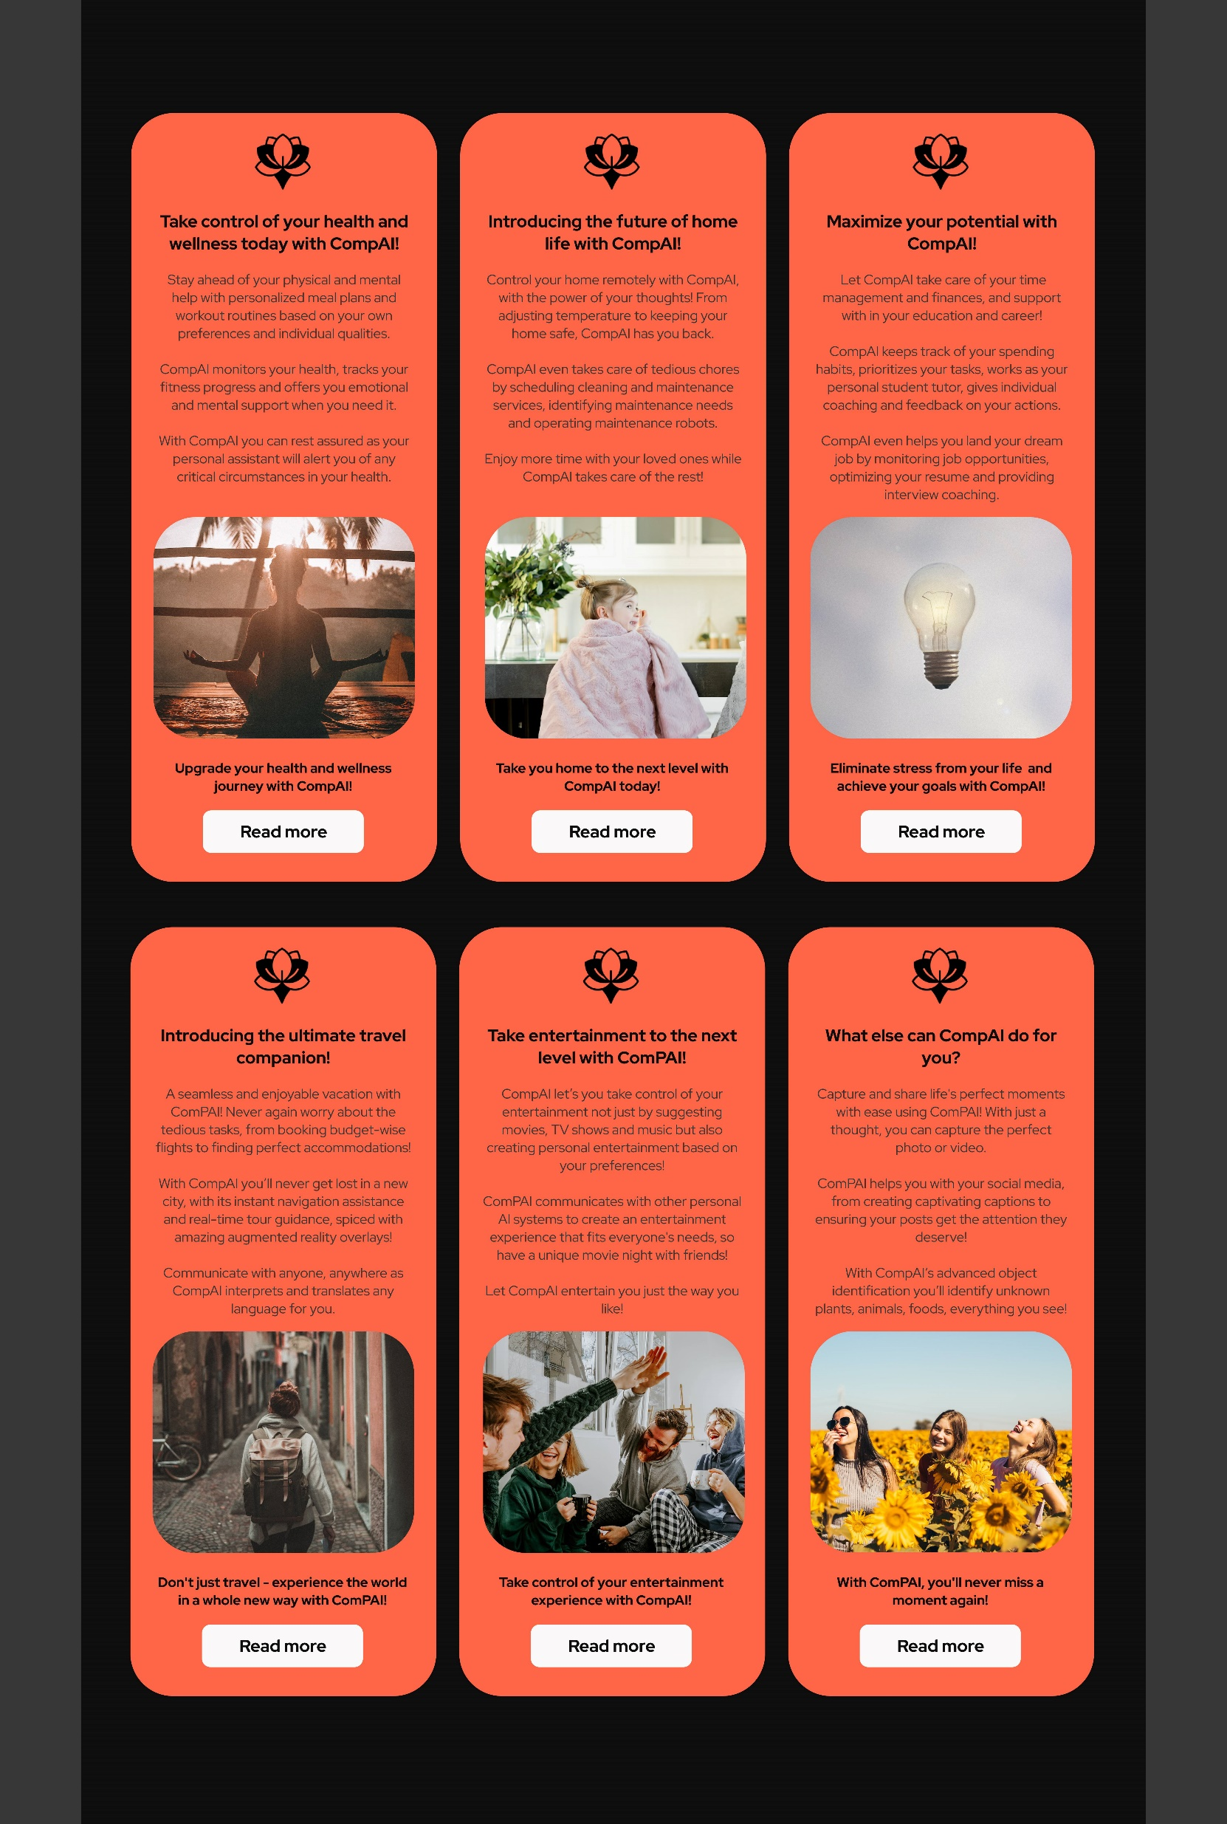

Slide 17
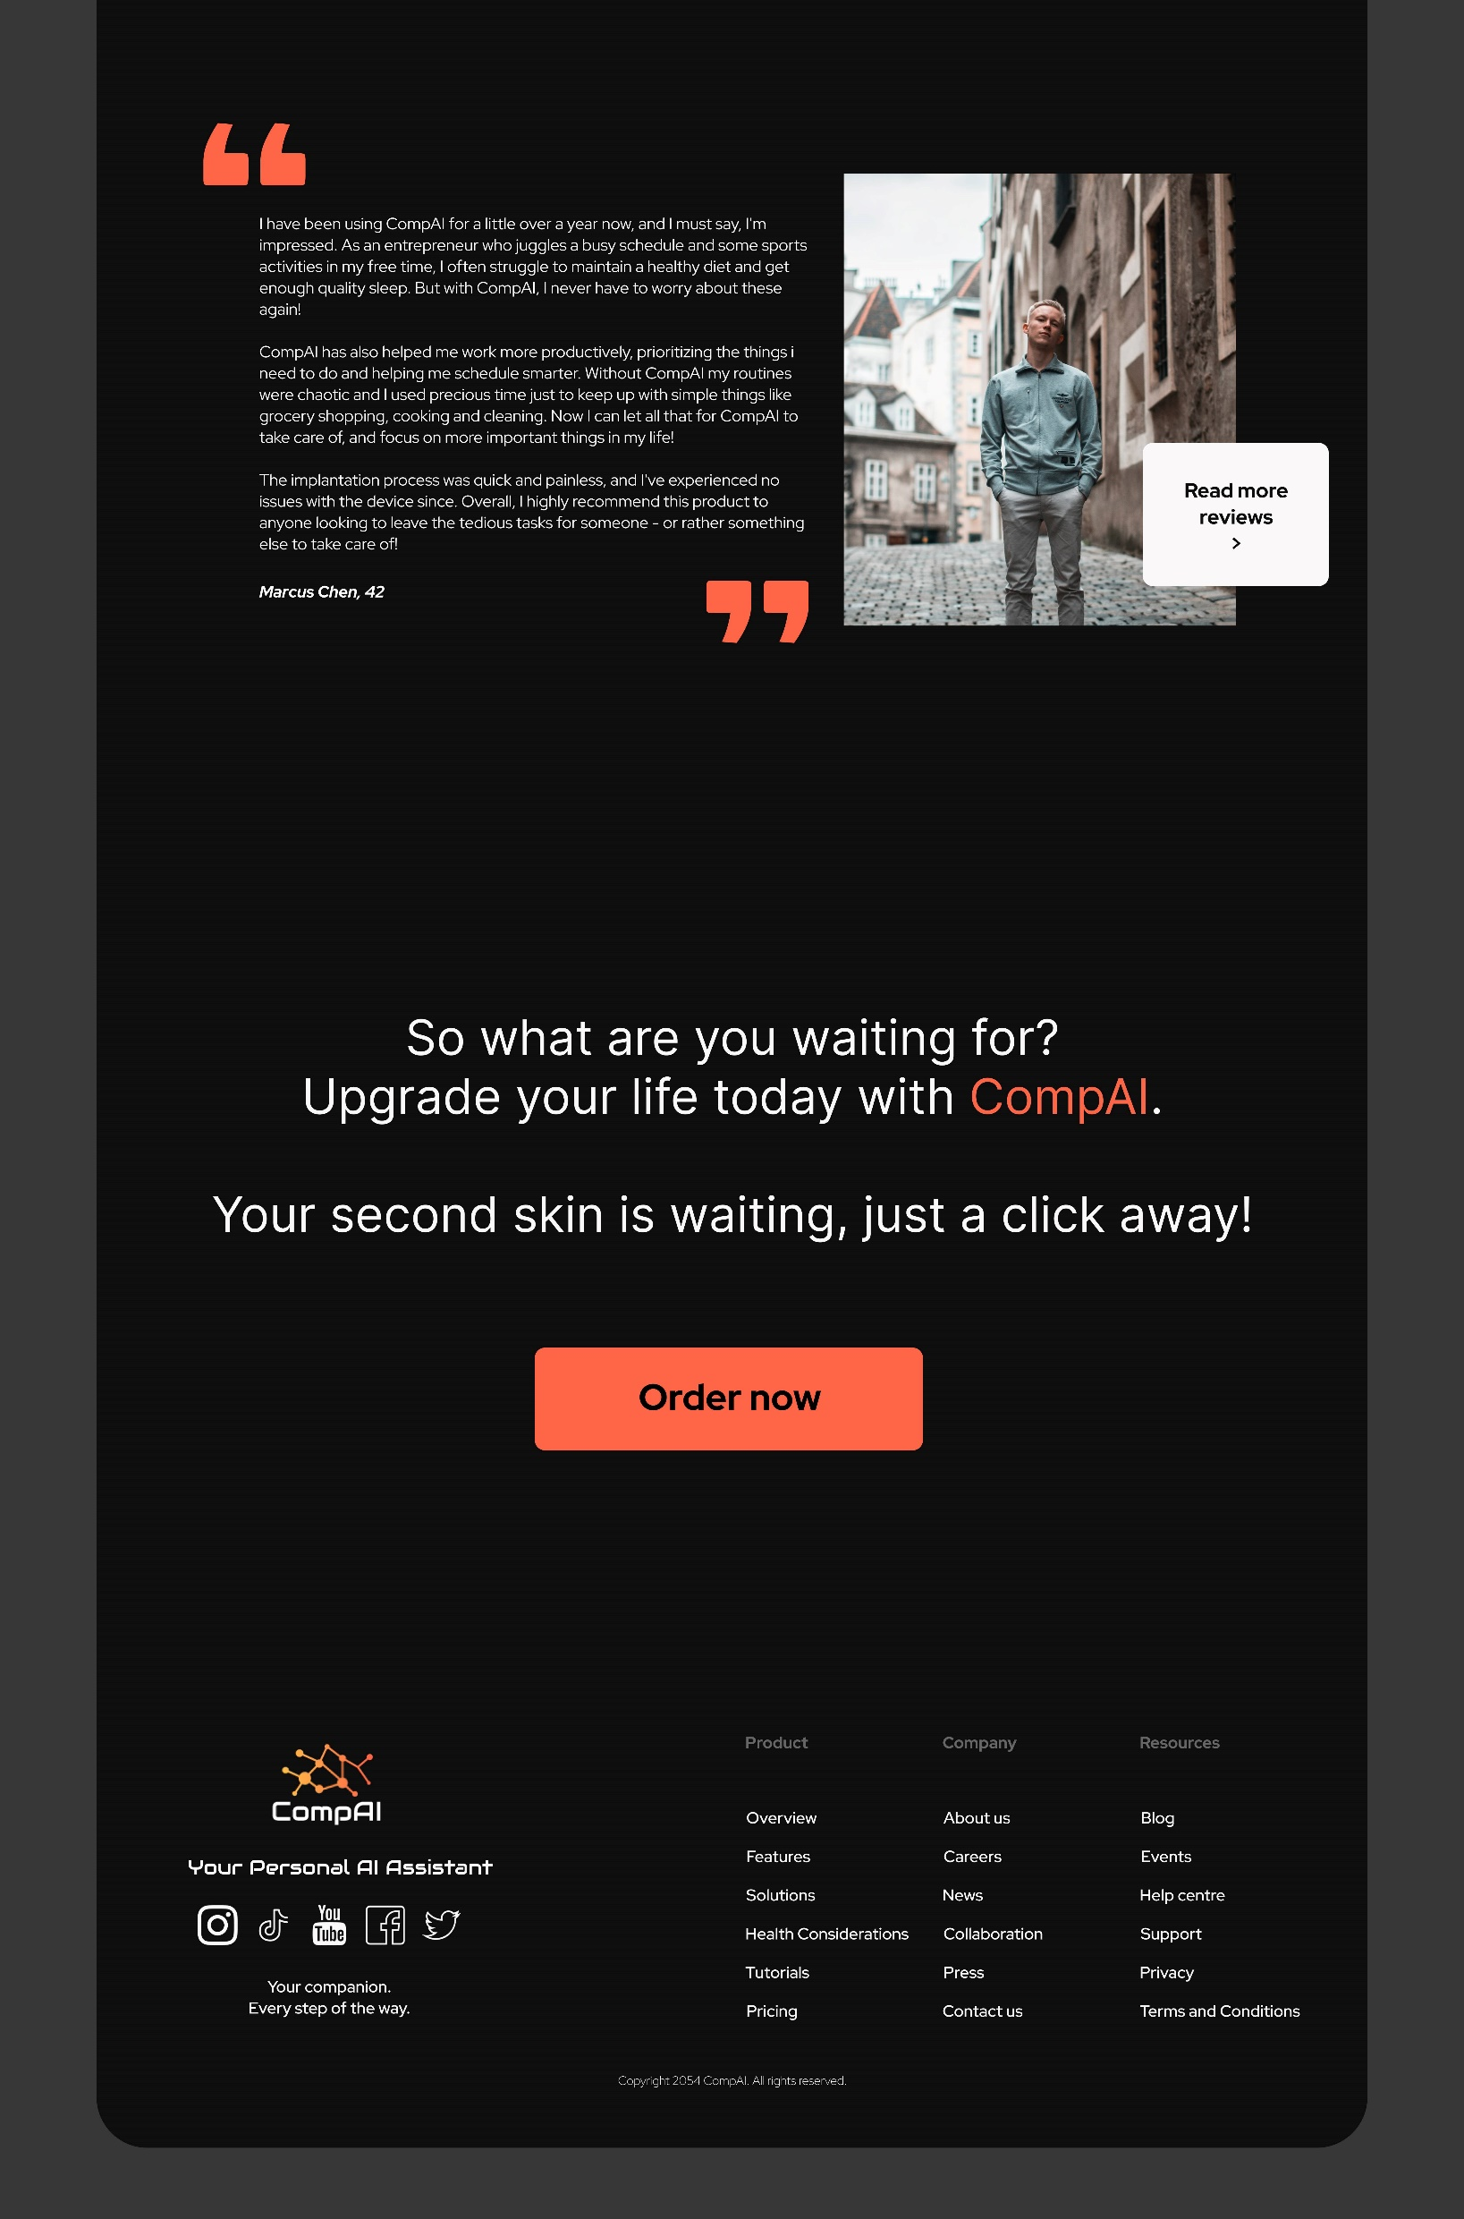

Slide 18

Demo 2: PRODUCT Features
Communicate through your mind without any hassle by inconspicuos implant.
Here are couple examples how CompAI could be used in everyday life – imagine all this happening in real time, within your thoughts.

Slide 19
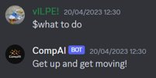
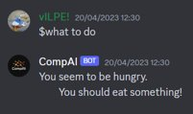
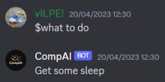
You have the control
Ask questions and recommendations​
Personalize your experience​

Slide 20
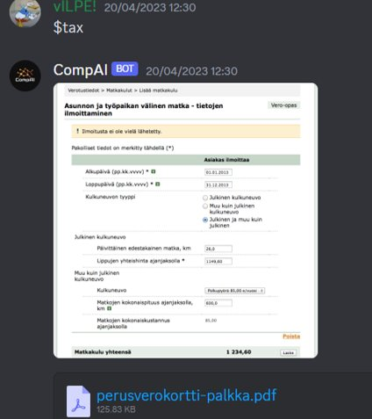
Automate boring tasks
For example, fill forms automatically based on your finances​
Remember things for you​
Allows you to focus on more important stuff

Slide 21
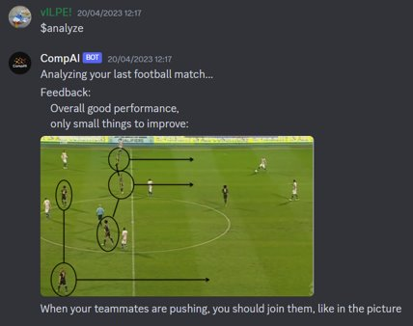
Helps you improve
Ask CompAI analyze your performance for example after a football match​
Gives in depth feedback

Slide 22
backcasting
There are a lot of smaller changes that need to happen to make a bigger change. These changes will happen in almost every area one way or another. Many new innovations connect to healthcare one way or another. With that being said the healthcare might be the first big field to see an impact of AI.
One of the biggest changes is advancements in technology. New innovations and possibilites unloced by them opens new possibilities. At the same time methods to make and train AI models improve making the impact even larger.
For the AI to be used, the legislation needs to be updated accordingly to make sure AI is used in a secured environment while obeying privacy.
Changing the public mindset should happen more widely to get new innovations going. New methods to use AI may be overwhelming for majority of people. With informative and transparent introductions people would understand new technologies better and with that be more open minded.

Slide 23
Conclusion
We are aware that our product idea is still a very futuristic and far-fetched, regardless of the seeds that have already been planted in the technological field. Many steps have to be taken, many obsticles to overcome.
A study¹ in Osaka University, Japan (2023) has taken the first steps towards an AI model that can read messages from human brain through MRI-technology.
Google has patented contact lenses with a built-in camera as early as in 2012.² Altough the technology still has many issues, the will to find a working solution is there. Installing a camera in regular glasses is easier and has alredy been done, and even in an affordable price.
Because of the high cost and simplicity of the technology in the beginning, we expect these equiments needed to see their first performance in the medical field, where AI can assist people with for example speech or vision impairment to communicate and interact with their surroundings.
¹ ”‘Mind-reading’ AI: Japan study sparks ethical debate”, Aljazeera, April 7, 2023. Link: https://www.aljazeera.com/economy/2023/4/7/could-ai-read-minds-somedayjapanese-breakthrough-sparks-debate
² ”Google invents smart contact lens with built-in camera: Superhuman Terminator-like vision here we come”, Extreme Tech, April 15, 2014. Link: https://www.extremetech.com/extreme/180571-google-invents-smart-contact-lens-with-built-in-camera-superhuman-terminator-like-vision-here-we-come

Slide 24
Personal interpretations
William Reima
Artificial intelligence is here to stay and I firmly believe we’re just at the beginning of a disruption it’s going to have to the whole world. As a third year student at TAMK studying ICT-engineering I’ve got a bit of understanding about a technical aspects of AI overall. I believe impact to everyday life will be significant in near future. Just now we’re starting to see and understand the actual possibilities and effects.

Slide 25
O R IMON
I think the future of work with AI is likely to be more creative and it
will be more potential to automate many routine and
repetitive tasks, allowing human workers to focus on more creative
and complex tasks that require problem-solving and critical
thinking skills. I have some knowledge of some of the more
technical parts of AI as a third year student studying software
engineering at TAMK. In the future of AI, businesses will need to
invest in advanced technologies such as machine learning,
Natural language processing, and computer vision. These
technologies will enable AI systems to process and analyze vast
amounts of data, learn from that data, and make informed
decisions in real-time. The future of work with AI is likely to be
characterized by increased collaboration between human workers
and AI systems. This will require a shift in how we think about work
and how we organize our workplaces.

Slide 26
Minna mellajärvi
For me the rise of AI in my personal life came as a bit of a surprise. I hadn’t thought I’d have any use for it, but since starting my studies at TAMK I came to realize how wrong I was. I have taken ChatGPT in frequent use in my coding studies, as well as in my freelancer translation job, along with DeepL translator.
The full potential of AI is still to be realized, and I believe we will see some rapid changes in our everyday lives as the technology develops further. Quick changes are also needed in the legal and political decisions around the growth of these new tools – it is already possible to use AI for criminal activities too.
One other thing that worries me in the rise of AI are the environmental aspects. Of course, it’s clear that AI can be very useful and helpful in the handling of environmental issues, analyzing huge amounts of data and making predictions based on that. With AI we can learn to reduce emissions on various areas of life, but the downside is that AI also causes a part of these emissions.

Slide 27
My background is in the Media and Arts field, and even though I should feel worried for my future, where AI can create things as well as I can, I am not. I see the possibilities that AI can bring –quick template pictures for designs, inspiration to visual and musical artists, fast editing of photos and videos, you name it!
I think people shouldn’t try to fight against the changes AI brings, they should see how could they harness it to help them in their own work and daily lives.
I have realized this spring that AI can make my work easier, and I can’t wait to see what are all the possibilities there are to be achieved with these new tools that are being launched all the time!

